Slide 1

Go, change the world
RV College of
Engineering
Department of Master of Computer Applications
18MCA 56 – Seminar- I – Phase 2
STEGANOGRAPHY IN IMPROVING SECRET COMMUNICATION
Ajith Naik(1RD18MCA02)
Under the Guidance of
Chandrani chakravorty
Assistant Professor
R V College Of Engineering

Slide 2
Agenda
Introduction
Literature Survey
Steganography Working
Steganography and Communication
Technical Relevance
Sustainability and Societal Concerns
Key competitors
Conclusion
References
*
2

Slide 3
Introduction
Steganography is another term for covert communication. It is the technique of hiding secret data within an ordinary, non-secret, file or message in order to avoid detection; the secret data is then extracted at its destination.
Data should be hidden in cover object in such a manner that just by viewing (image or video) or listening (audio), you cannot even judge that there is any data or not. It is used for security communication. Once it is detected that there is any data hidden, complete file can be destroyed so that the data cannot be delivered to the receiver.
Steganalysis is the study of detecting messages hidden using steganography; this is analogous to cryptanalysis applied to cryptography. The goal of steganalysis is to identify suspected packages, determine whether or not they have a payload encoded into them, and, if possible, recover that payload.
*
3

Slide 4
Literature Survey
S No | Author and Paper title | Details of Publication | Summary of the Paper
1 | Sparse Encoded Matrix based Steganography algorithm Vipul Shah M.E. Student, Department Of Computer Science | International Research Journal of Engineering and Technology (IRJET), Volume: 04 Issue: 04 | Apr -2017 , e-ISSN: 2395 -0056 | In this paper proposed approach uses sparse matrix encoding to increase the security of the algorithm. Also it can be seen that the proposed approach did as good as the Least Significant bit algorithm in terms of speed of execution and PSNR value whilst also giving additional security.
*
4

Slide 5
Literature Survey
S No | Author and Paper title | Details of Publication | Summary of the Paper
2 | Image Steganography and Data hiding in QR Code Rutuja Kakade, Nikita Kasar, Shruti Kulkarni, Shubham Kumbalpuri, Sonali Patil | International Research Journal of Engineering and Technology (IRJET), Volume: 04 Issue: 05 | May -2017, e-ISSN: 2395 -0056 | In this paper authors have considered securing criminal data as one of its applications. The criminal information may be changed for misleading the police department. The data that can be changed or tampered is mainly the type of crime performed, which can be changed for reducing the punishment of the culprit. The proposed system provides security to criminal data from unauthorized access and tampering.
*
5

Slide 6
Literature Survey
S No | Author and Paper title | Details of Publication | Summary of the Paper
4 | A Comparative Study of Audio Steganography Techniques Palwinder Singh,Assistant Professor, Guru Nanak Dev University, Amritsar | International Research Journal of Engineering and Technology (IRJET), Volume: 03 Issue: 04 | Apr-2016 , e-ISSN: 2395 -0056 | In this paper comparative study of different audio steganography techniques and their approaches is presented. Audio steganography techniques can also be combined with existing cryptography methods so along with encryption information can also be made hidden. The advantage of one technique over other depends upon the type of application and its requirements.
*
6

Slide 7
Literature Survey
S No | Author and Paper title | Details of Publication | Summary of the Paper
4 | A new hybrid encryption and steganography technique: a survey Apoorva Shrivastava and Lokesh Singh | International Journal of Advanced Technology and Engineering Exploration, Vol 3(14) ISSN (Print): 2394-5443 ISSN (Online): 2394-7454 | This paper consists of several aspects of cryptography and steganography with their working approached and enhancements. Based on the analysis and observations they have suggested encryption technique like RC6. It would be better to hybrid different encryption technique. The increasing size of key with random attribute is also a better and powerful security improvement.
*
7

Slide 8
Literature Survey
S No | Author and Paper title | Details of Publication | Summary of the Paper
5 | A Steganography Scheme on JPEG Compressed Cover Image with High Embedding Capacity Arup Kumar Pal , Kshiramani Naik , and Rohit Agarwal | The International Arab Journal of Information Technology, Vol. 16, No. 1, January 2019 | In this paper, authors have proposed a JPEG cover image based steganography with high visual quality along with high embedding capacity stego image. The proposed scheme is compared with some other related existing methods such as JSteg, F5, OutGuess,] scheme and satisfactory results have been found. It is used for covert communication, featured tagging, copyright protection, military agencies and for many more applications related to secure communications.
*
8

Slide 9
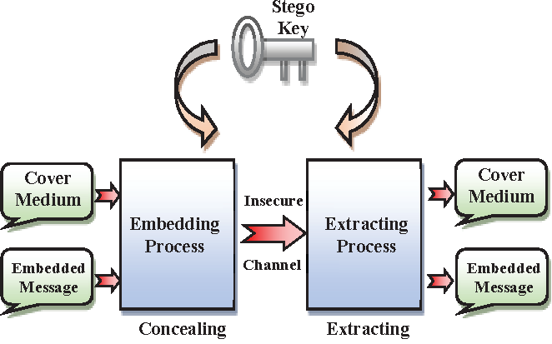
Steganography Working
The formula below describes the process of steganography :
cover medium + hidden data + stego key = stego medium
*
9

Slide 10
Steganography and Communication
Multilevel steganography can be efficiently used as secret communication carrier. So, the multilevel steganography may be classified as like below:
Single message multiple covers
(ii) Single cover multiple messages
*
10

Slide 11
Technical Relevance
Steganographic technologies are a very important part of the future of Internet security and privacy on open systems such as the Internet. Steganographic research is primarily driven by the lack of strength in the cryptographic systems on their own and the desire to have complete secrecy in an open-systems environment. Steganography can be used to hide important data inside another file so that only the parties intended to get the message even knows a secret message exists.
Cover Media and General Steganography Techniques:
1. Text steganography
2. Audio and video steganography
3. Image steganography
*
11

Slide 12
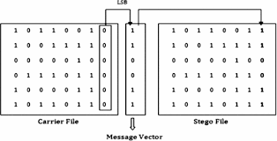
Technical Relevance
3 popularly used Steganography Techniques
Least Significant Bit
The Least Significant Bit (LSB) steganography is one such technique in which least significant bit of the image is replaced with data bit. As this method is vulnerable to steganalysis so as to make it more secure we encrypt the raw data before embedding it in the image.
*
12

Slide 13
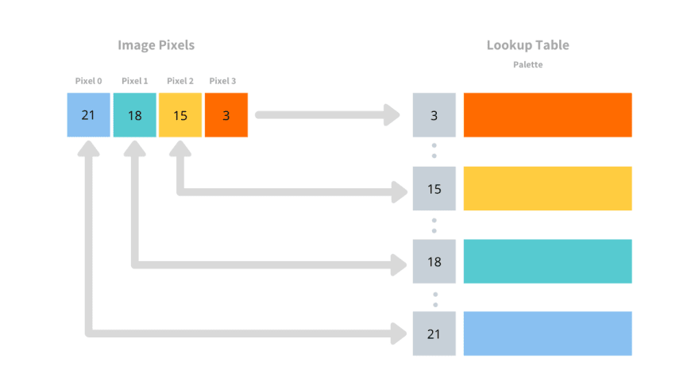
Technical Relevance
2. Palette Based Technique
This technique also uses digital images as message carriers. Here, the users first encrypt the message and then hide it in a stretched palette of the cover image. Even though this technique can carry a limited amount of data, it is very hard to find embedded messages since the message is encrypted and takes a lot of time to decrypt.
*
13

Slide 14
Technical Relevance
3. Secure Cover Selection
This is a very complex technique where the users compare the blocks of the carrier image to the blocks of their specific message. If an image with the same blocks as the message is found, it is chosen as the candidate to carry the message. The identical message blocks are then carefully fitted into the carrier image. The resulting image is identical to the original and the best part is that this image is not flagged .
*
14

Slide 15
Sustainability and Societal Concerns
As all the technologies Steganography also contains both advantages and disadvantages
Some of the Advantages are:
Steganography helps to send news and information without being censored and being traced back to us.
Steganography can also be used to implement watermarking.
With the use of Steganography Corporation government and law enforcement agencies can communicate secretly.
Within an X-Ray copy, the details of the patient and her/his health problem can be hidden without disturbing the X-ray film quality, of course with an encryption which can be opened only with a key available to the diagnosing doctor.
*
15

Slide 16
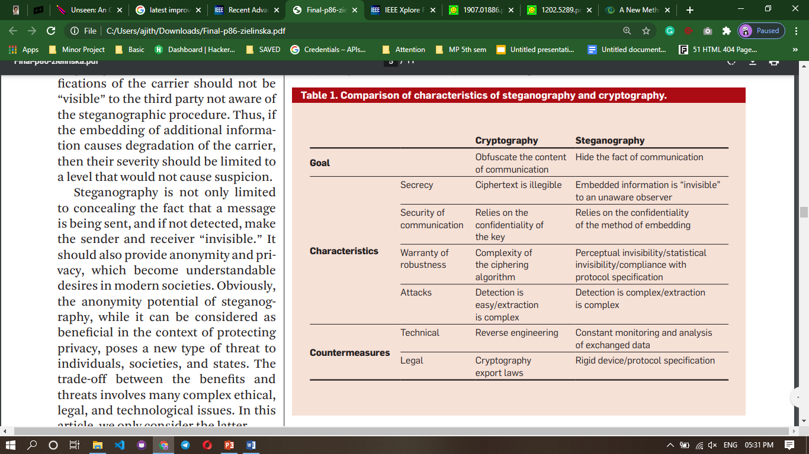
Key competitors
*
16

Slide 17
Key competitors
The advantage of steganography, over cryptography alone, is that messages do not attract attention to themselves.
Important files carrying confidential information can be in the server and in encrypted form. No intruder can get any useful information from the original file during transmit.
Cryptography is widely used in computer networks, mobile phone networks, ATM networks, etc. Cryptography helps to authenticate a user and encrypt the data.
Cryptography turns plaintext into cipher text. Steganography hides information. There have been suggestions that both can be used in conjunction with one another. In other words, you can encrypt information then hide the result in a picture
*
17

Slide 18
Conclusion
Steganography is a fascinating and effective method of hiding data that has been used throughout history. Steganography transmits secrets through apparently many covers in an effort to conceal the existence of a secret. Digital image steganography and its derivatives are growing in use and application . In areas where cryptography and strong encryption are being outlawed, citizens are looking at steganography to overcome such policies and pass messages covertly. In the near future, the most important use of steganographic techniques will probably be lying in the field of digital watermarking. Also Content providers are eager to protect their copyrighted works against illegal distribution and digital watermarks provide a way of tracking the owners of these materials. Steganography might also become limited under laws, since governments already claimed that criminals use these techniques to communicate. There are many good reasons as well as to use this type of data hiding, including watermarking or a more secure central storage method for such things as passwords, or key processes. Regardless, the technology is easy to use and difficult to detect. The more that you know about its features and functionality, the more ahead you will be in the game.
*
18

Slide 19
References
Sparse Encoded Matrix based Steganography algorithmVipul Shah M.E. Student, Department Of Computer Science, International Research Journal of Engineering and Technology (IRJET), Volume: 04 Issue: 04 | Apr -2017 , e-ISSN: 2395 -0056
Image Steganography and Data hiding in QR Code ,Rutuja Kakade, Nikita Kasar, Shruti Kulkarni, Shubham Kumbalpuri, Sonali Patil , nternational Research Journal of Engineering and Technology (IRJET), Volume: 04 Issue: 05 | May -2017, e-ISSN: 2395 -0056
A new hybrid encryption and steganography technique: a survey,Apoorva Shrivastava and Lokesh Singh, International Journal of Advanced Technology and Engineering Exploration, Vol 3(14) ISSN (Print): 2394-5443 ISSN (Online): 2394-7454
A Comparative Study of Audio Steganography Techniques Palwinder Singh,Assistant Professor, Guru Nanak Dev University, Amritsar, International Research Journal of Engineering and Technology (IRJET), Volume: 03 Issue: 04 | Apr-2016 , e-ISSN: 2395 -0056
A Steganography Scheme on JPEG Compressed Cover Image with High Embedding Capacity,Arup Kumar Pal , Kshiramani Naik , and Rohit Agarwal, The International Arab Journal of Information Technology, Vol. 16, No. 1, January 2019
*
19

Slide 20
THANK YOU
*
20

